Slide 1
Haven Pools
MGS351 Group 1
Samuel Ackerman
Xubo Bi
Yixiang Huang
Shane Murphy
Notes:
Charles

Slide 2
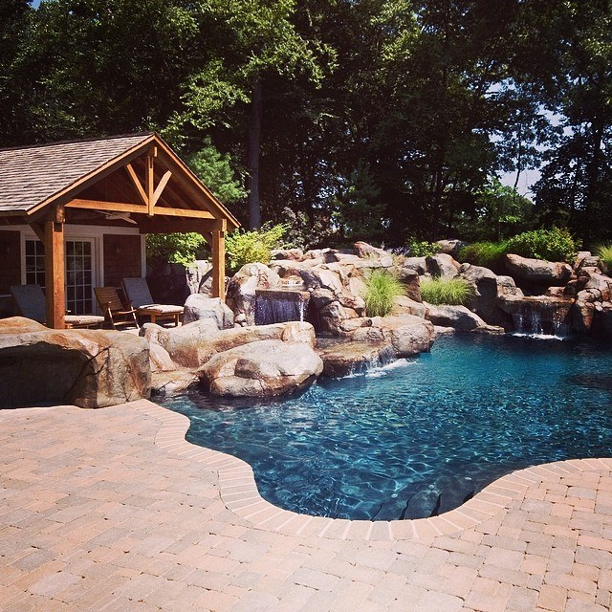
Agenda
Background
Website Introduction
Current Problems of Haven Pools
Aim of Our Database
Project Demonstration
Conclusion
Notes:
Charles

Slide 3
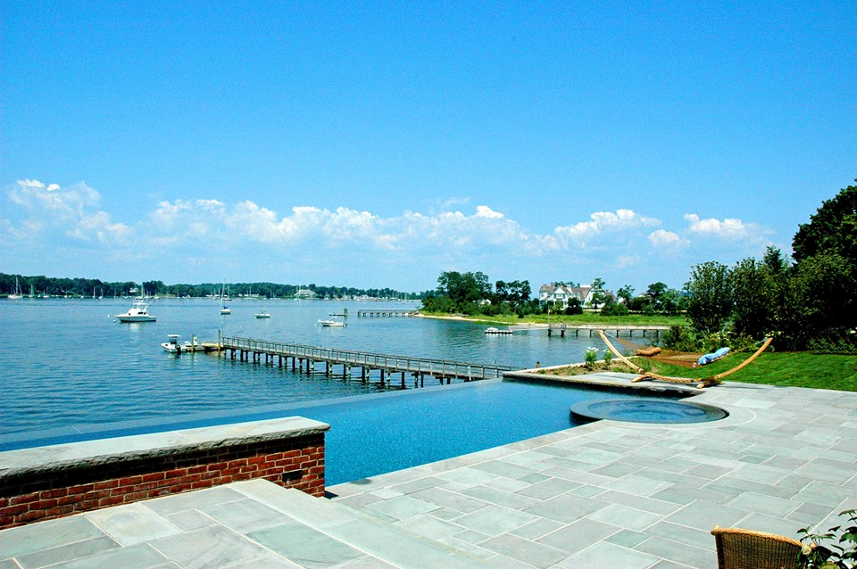
Current Problems
Lack of communication
Overbooking projects
Disappointed customers & employees
Organizational hierarchy breakdown
Increased account receivable balance
Continual improvement
Misuse of work vehicle
Notes:
Sam

Slide 4
Database Goals
Decision Making
Continual Improvement
Communication
Work Ethic
Organization
Notes:
Xubo - Overall increase the effectiveness of decision making through these four categories. More organized environment, greater communication, as well as more oversight on employees in order to increase work ethic and job quality.

Slide 5
Elements of Database
Customer tracking
Customer reports
Employee identification
Employee queries & reports
Maintenance documentation
Maintenance jobs reports & queries
Payment records by customer
Payment reports
Vehicle identification by employee
Vehicle assignment report

Slide 6
Database Demonstration
Now we will bring you to a quick demonstration of the database
Show you the business value of the database
Notes:
Shane

Slide 7
Problems fixed through database
We aim to solve the organizational problem of the company through our database
As well as the problem of communication between the office and on site employees
Finally, the tracking of jobs and vehicles used on those jobs
Notes:
Sam

Slide 8
Conclusion
Convey information better to the field workers.
Make the company work effectively and efficiently.
Increased system for communication and organization
Create an environment more friendly to customers and employees
Notes:
Xubo

Slide 9
Questions?

